Slide 1

Project Title – AirBNB Hotel Booking Analysis
[Haarthi Vallabhaneni ]
[STU657da33295f551702732594]

Slide 2

PROBLEM STATEMENT
The hospitality industry has undergone a significant transformation with the rise of online platforms facilitating short-term lodging and tourism. Leading this revolution is Airbnb, Inc., a pioneering American company that has reshaped travel accommodation through its innovative online marketplace. Established in 2008 in Sen Francisco, California, Airbnb provides a diverse range of lodging options, offering guests a unique and personalized experience. Unlike traditional hospitality providers, Airbnb operates on a commission based model, facilitating transactions between hosts and guests without owning the properties listed on its platform.
This research analysis delves into the New York City Airbnb dataset to extract meaningful insights. Through rigorous data cleaning, exploratory analysis, and visualization techniques, the study aims to illuminate the dynamics of the city's lodging market. By discerning factors influencing listing availability, pricing strategies, and overall customer satisfaction, the research contributes to a deeper understanding of Airbnb's operations in one of the world's most dynamic urban environments. These insights hold significance for stakeholders and enthusiasts seeking to navigate the evolving landscape of short-term accommodation

Slide 3
PROJECT DESCRIPTION This project aims to analyze Airbnb hotel booking data to uncover patterns, trends, and insights that can help improve decision-making for hosts and enhance the overall guest experience. By examining booking behaviors, pricing strategies, guest preferences, and host performance, we seek to identify key factors that drive successful bookings and high guest satisfaction Key Objectives: Booking Patterns: Identify peak booking seasons, variations by location, and average booking lead times. Pricing Strategies: Examine effective pricing strategies, the impact of seasonality, and the relationship between pricing and guest satisfaction. Guest Preferences: Understand the amenities and features most desired by guests, how preferences vary, and the factors leading to higher ratings. Host Performance: Analyze practices of high-performing hosts, the impact of host responsiveness, and common guest complaints

Slide 4

WHO ARE THE END USERS?
Hosts – Airbnb property owners or managers who can use the analysis to optimize pricing,
improve guest satisfaction, and enhance booking performance.
Guests – Travelers who benefit indirectly through better accommodation options,
improved services, and more accurate pricing.
Airbnb Platform/Management – The company itself can use these insights to improve platform policies,
support hosts, and enhance the overall user experience.
Market Analysts/Researchers – Individuals or organizations studying trends in the hospitality
industry for research, investment, or strategic planning purposes.

Slide 5

Technology Used
Python - Core programming language
Pandas & NumPy - Data cleaning and preprocessing
Matplotlib/Seaborn- Data visualization and feature importance
Google Colab - Cloud-based environment for running the project File handling libraries
openpyxl (for Excel) and built-in CSV handling

Slide 6
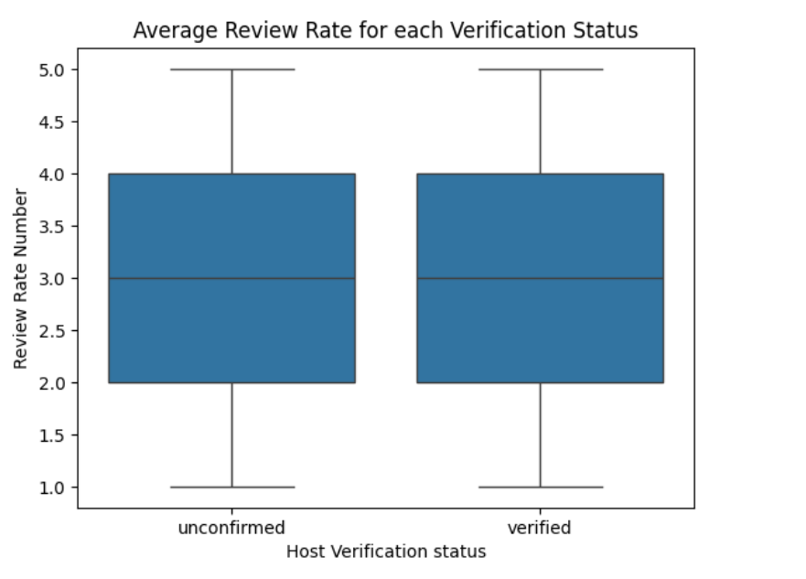
RESULTS1

Slide 7
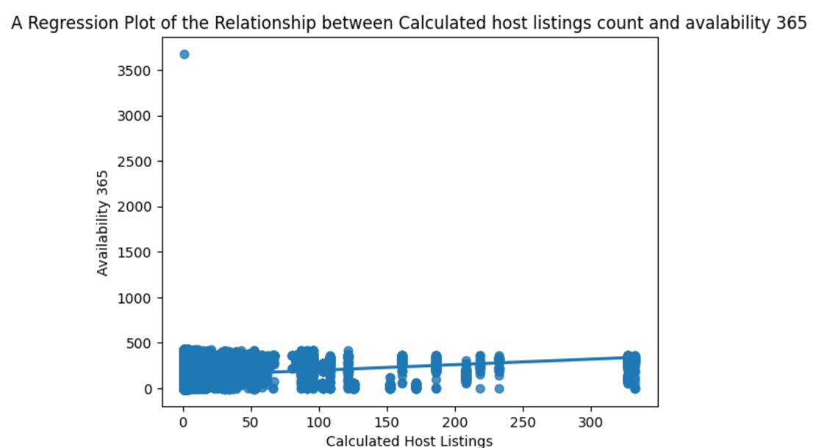
RESULTS2

Slide 8
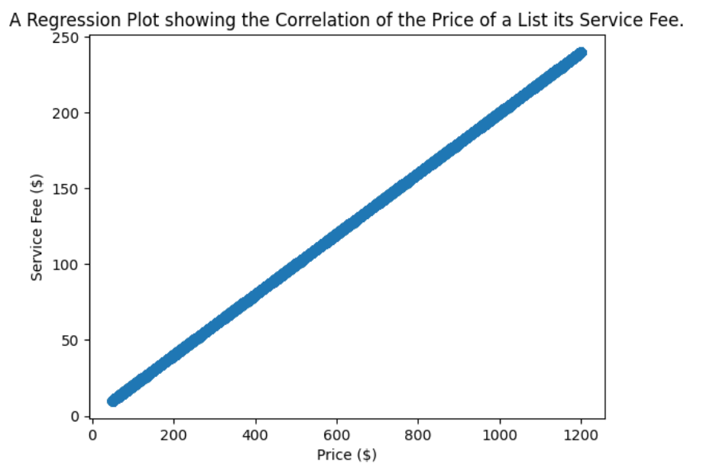
RESULTS3

Slide 9
GitHub repository
HaarthiV13/VOIS_AICTE_Oct2025_VallabhaneniHaarthi

Slide 10

Getting started with Basics of Python Certificate

Slide 11

Data Visualization Certificate

Slide 12
Thank you
.
.

